Slide 1

INFRASTRUCTURE MANAGEMENT SYSTEM
Under The Supervision of
Mr. Y. Suresh M.Tech(Ph.D);
Assistant Professor
Department of Information Technology
Vasireddy Venkatadri Institute of Technology
Padakakani Mandal, Namburu, Gunturu-522508

Slide 2
CONTENTS OUTLINE
Title and Roles Of Students 1-3
Abstract 4
Introduction 5
Proposed System with Architecture 6
Objectives of Proposed System 7
Modules Introduction 8
System Requirements 11
Hardware Configuration(Computer Resource)
Software Configuration(Technology Stack)
Design 13
Use Case diagram
Class diagram
Sequence Diagram
Execution Screenshots 16
Conclusion and Future Work 18

Slide 3
Roles of Students :
Team No | Name | Roll No | Role
C3 | VAKA SRAVANTHI SOWMYA NAFISA SINDHU | 21BQ1A12G7 21BQ1A12H8 21BQ1A12E3 21BQ1A12D1 | FONT-END FONT-END FONT-END FONT-END
C13 | NARENDRA AJAY RAJESH YUVARAJ | 21BQ1A12G3 21BQ1A12E7 21BQ1A12I1 21BQ1A12H5
C8 | PAVAN DILEEP SAIPAVAN TEJA VENKAT | 21BQ1A12G1 21BQ1A12F3 21BQ1A12D5 21BQ1A12C7 22BQ5A1223

Slide 4
ABSTRACT
In Infra Structure Management, the students face many issues regarding inefficient resource allocation, resulting in frustration among college students. The Project presents a user-friendly approach to resolving these issues and creating a more accommodating learning environment. Students will be provided with a unique ID and password for logging into the system. This application is used for handling complaint-related Resources to get Solutions from the Admin, which is a part of this System.
This method will improve the process of Infra Structure management inside the organization by saving time and resources, reducing the paperwork, and maintaining records efficiently and systematically. It will also give the data regarding the count of computers that are not working/Working, Available Classrooms list, in an easy and understandable Format.
By embracing an Infrastructure Management System, colleges can effectively address these challenges and enhance resource management for the benefit of their students.

Slide 5
INTRODUCTION
Infrastructure management refers to the maintenance of physical facilities, such as classrooms and labs, to ensure they meet the needs of students and faculty.
The aim of this project is to review current research studies on how infrastructure affects students’ learning outcomes . This project provides a user-friendly interface for staff and students to access and manage resources effortlessly.
Benefits of Infrastructure Management System include:
Audio-Visual Equipment: Ensuring that classrooms are equipped with projectors, screens, and audio systems to facilitate interactive learning.
Computers: Providing access to computers and relevant software applications in labs for research.
Quality of Education: Well-maintained classrooms and labs directly impact the quality of your education. They provide comfort in learning.
Resource Availability: Effective infrastructure management ensures that equipment, technology, and resources are readily available when you need them.

Slide 6
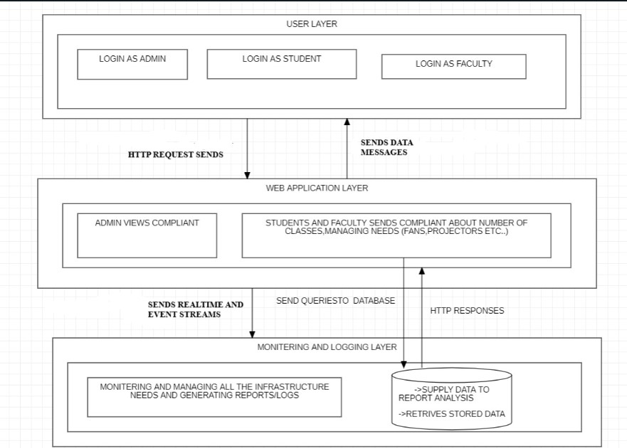
PROPOSED SYSTEM WITH ARCHITECTURE

Slide 7
OBJECTIVES OF PROPOSED SYSTEMS
1.Maintenance and Upkeep: Regularly inspect, maintain, and repair classroom and lab facilities to ensure they are safe, clean, and in good working condition.
2.Accessibility: Ensure that all classrooms and labs are accessible to individuals with disabilities, complying with accessibility standards and regulations.
3. Technology: Integrate and maintain technology infrastructure, such as audiovisual equipment, projectors, and smart boards, to support modern teaching methods.
4. Streamline maintenance and repairs: Enable quick reporting and tracking of maintenance issues and service requests
5. Optimal Resource Allocation: Ensure that classrooms and labs are allocated efficiently, matching the size and features of the space to the specific needs of courses and research activities.
6. Equipment Availability: Ensure that specialized equipment and materials required for experiments or research are available, properly maintained, and in good working order.

Slide 8
MODULES OF PROPOSED SYSTEM
The System contains certain Modules like
Admin Module:
In the admin module of the Infrastructure Management Project, administrators can securely log in to access and review user complaints related to classrooms and labs.
This module provides a user-friendly interface that allows admins to view a list of complaints, including details such as the nature of the issue and its status.
Admins have the authority to update the status of each complaint, marking it as "solved" once the problem has been resolved, ensuring efficient management and tracking of infrastructure-related concerns.
Faculty Module:
The Faculty module in the Infrastructure Management Project enables administrators to log in and efficiently manage classroom and lab-related complaints. Through this module, administrators can view incoming complaints from faculty and students, as well as submit their own complaints if needed. They also have the ability to track the status of ongoing complaints and mark them as resolved once the issues are addressed.

Slide 9
Student Module:
The Student module in our Infrastructure Management Project provides a streamlined platform for students to log in and submit complaints or concerns related to classrooms and labs. Upon logging in, students can easily report issues they encounter, such as maintenance needs. This module ensures efficient communication between students and the administrative team, thereby enhancing the overall learning environment.
Classrooms Module:
The Classrooms module in the Infrastructure Management Project provides a user-friendly interface that displays a comprehensive list of available classrooms and labs within the institution. Users can easily access this module to submit complaints related to these facilities, ensuring quick and efficient resolution.
Labs Module:
It offers a comprehensive list of available labs, making it easy for users to select the specific lab they wish to report issues about. Additionally, the module tracks the status of each complaint, ensuring that users can monitor the progress of their requests and access information on previously resolved lab-related issues, thereby promoting efficient infrastructure management.

Slide 10
SYSTEM REQUIREMENTS
SOFTWARE REQUIREMENTS:
Visual studio
XAMPP(MYSQL,PHP)
HARDWARE REQUIREMENTS:
Ram : Minimum 4Gb
Rom : Minimum 256 Gb
Processor : I3 or equivalent processor

Slide 11
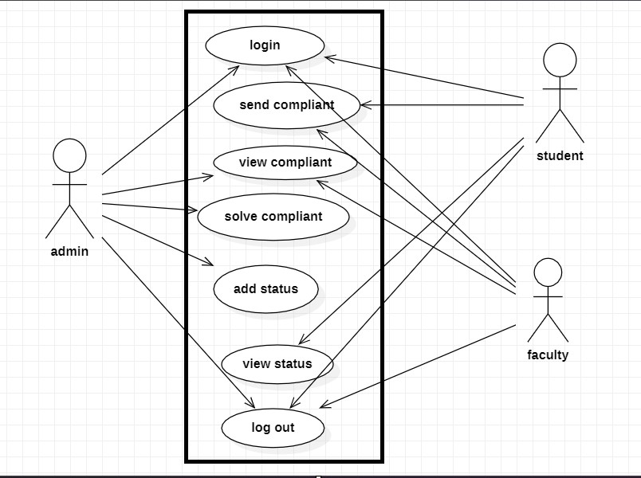
DESIGN
USE CASE DIAGRAM:

Slide 12
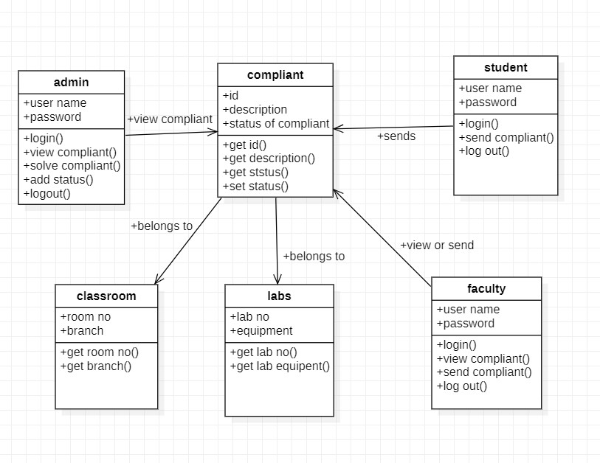
CLASS DIAGRAM:

Slide 13
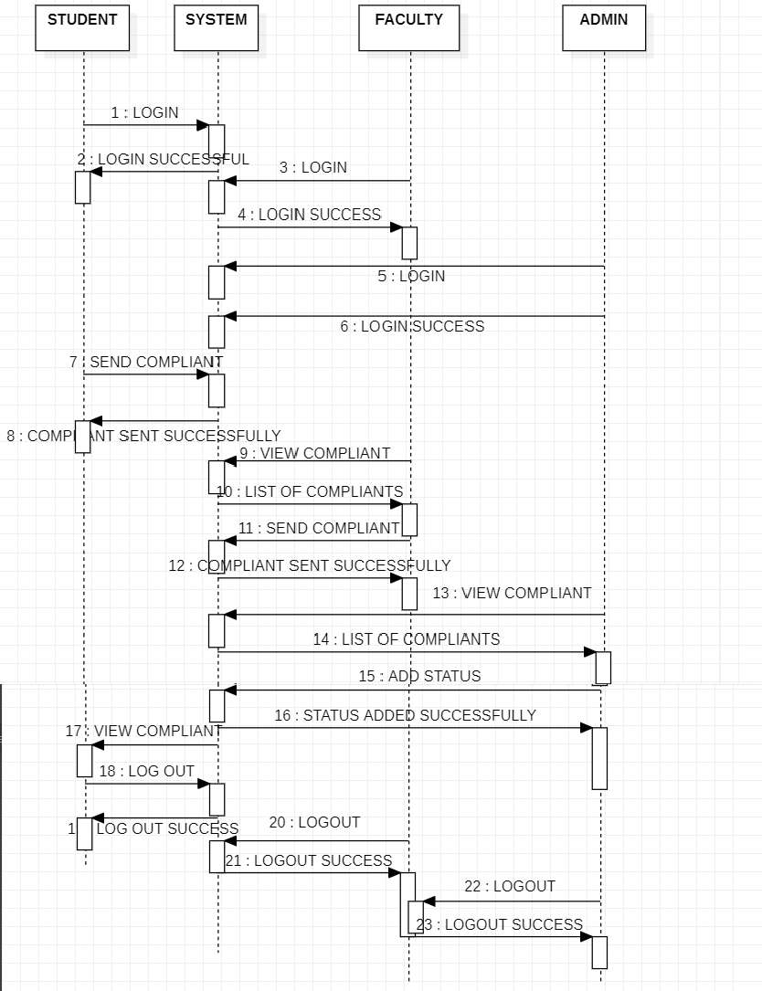
SEQUENCE DIAGRAM:

Slide 14
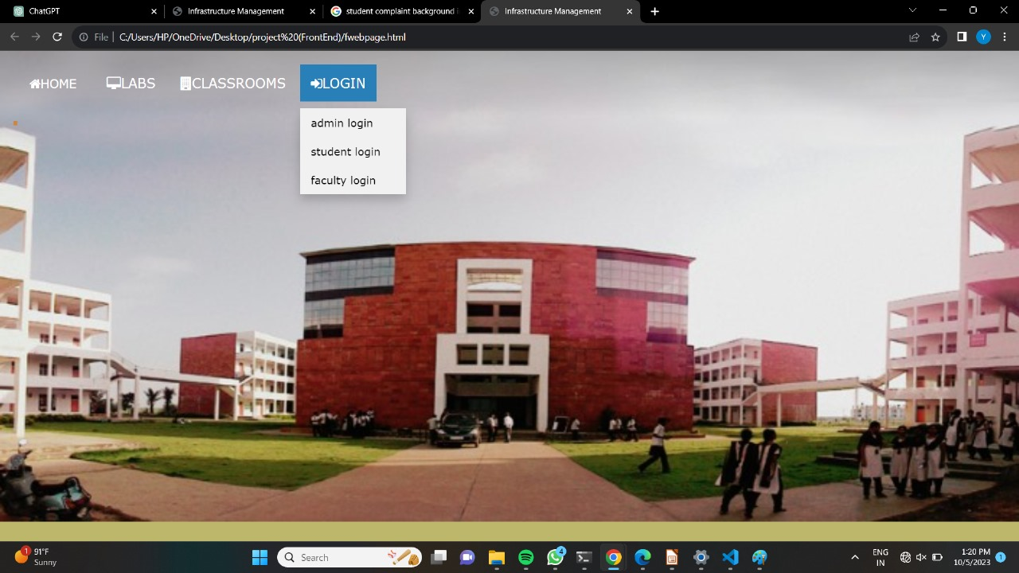
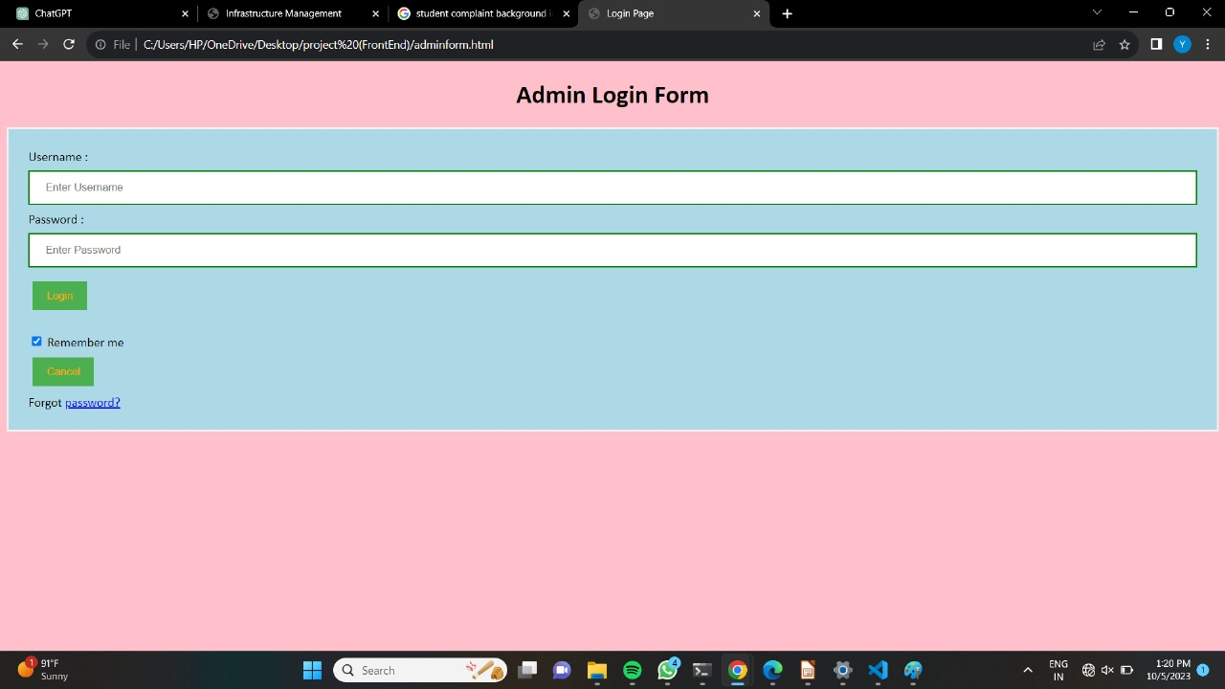
EXECUTION
Home page
Admin login form

Slide 15
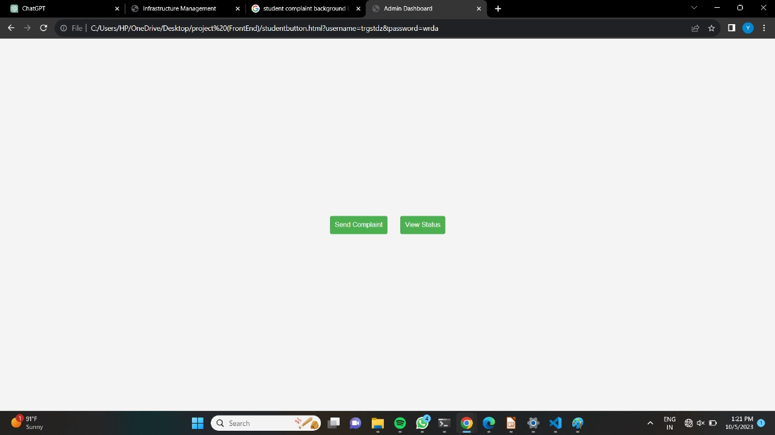
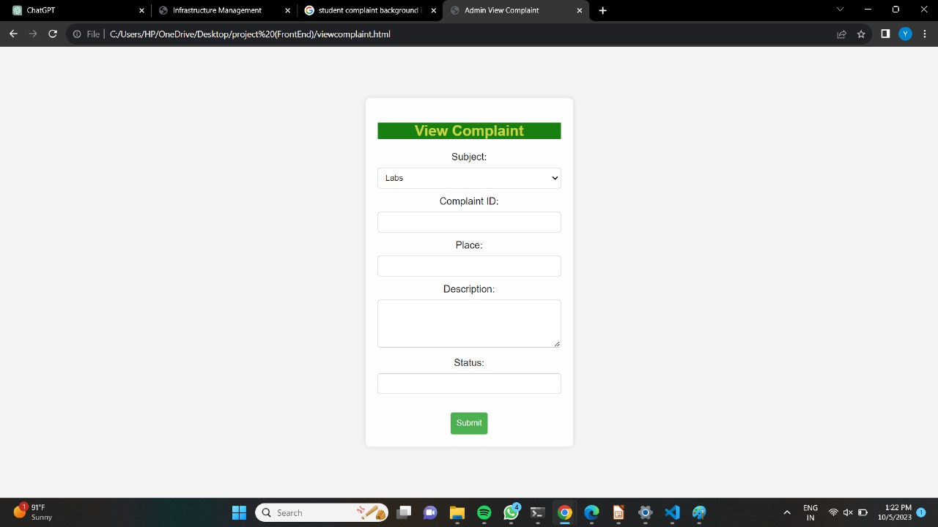
View after admin login
Complaint View

Slide 16
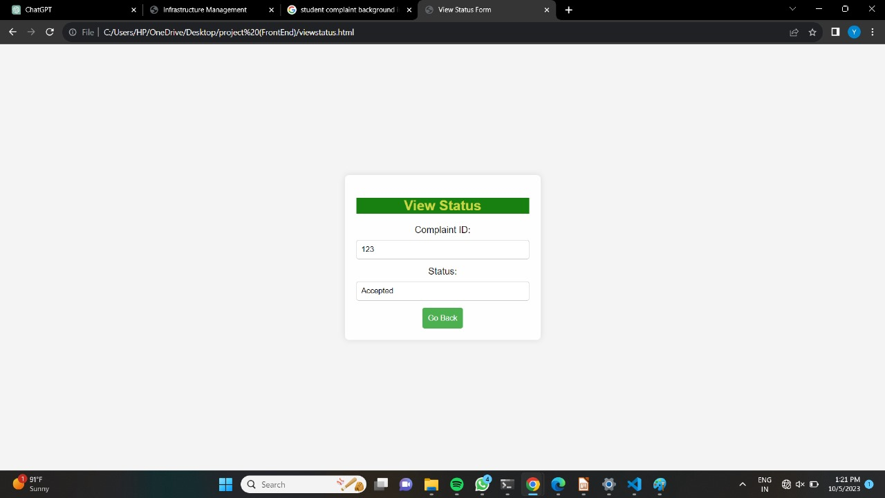
Status View

Slide 17
Conclusion and Future Work
Conclusion:
The Infrastructure Management System project has been a significant success in enhancing the overall efficiency and effectiveness of resource management within the college campus. By allowing students to send complaints, enabling administrators to view and resolve these complaints, and providing faculty with the means to report and track resource-related issues.
Key Achievements:
1. Improved Communication: The IMS has bridged the communication gap between students, faculty, and administrators. Students can easily report issues, faculty members can communicate resource-related problems, and administrators can swiftly address and resolve complaints
2. Efficient Resource Management: The system has facilitated better resource allocation, leading to optimal usage of classrooms and labs.
3. Data Analysis: Over time, the IMS has generated a valuable dataset of complaints and resolutions. This data can be analyzed to identify recurring issues and trends, enabling proactive infrastructure improvements.

Slide 18
Future Work:
Expanding and improving the Infrastructure Management System (IMS) project for managing resources like classrooms and labs for college students can involve several future developments and enhancements. Here are some ideas for future work on the project:
Complete Back-End Development:
We would like to complete the back-end development like, Where the admin can add status and students can view that status and we would like to include a date when the issue can be resolved.
Feedback and Rating System:
Add a feature that allows students and faculty to provide feedback and ratings for the resources they use. This can help in identifying areas for improvement.
Offline Mode:
Develop an offline mode that allows users to submit complaints and view resource information even when they don't have an internet connection, with automatic synchronization when back online.
Data Backup and Recovery:
Implement a robust data backup and recovery system to prevent data loss in case of system failures.

Slide 19
Thank You…!

